Slide 1


Unit 1: Lesson 1 Fresh start

Slide 2
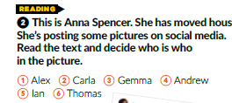
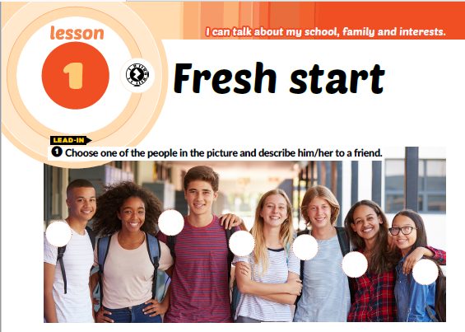

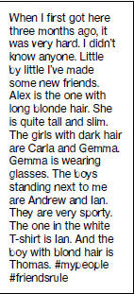
Textbook p.12
4
5
1
6
2
3

Slide 3
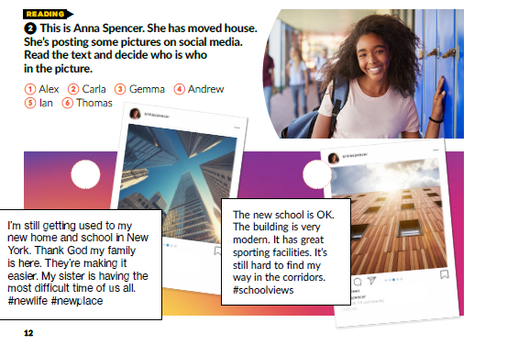
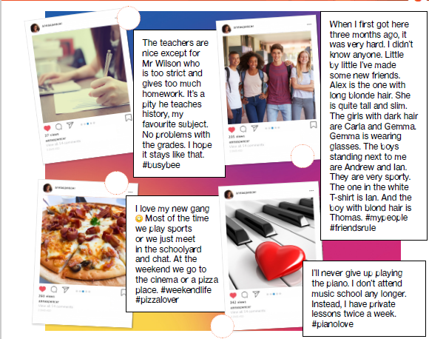
4
3
2
5
6
1

Slide 4
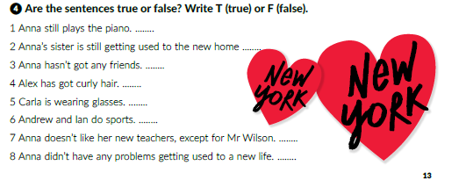
T
T
F
F
F
T
F
F

Slide 5
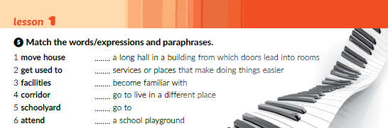
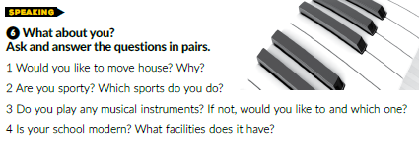
4
3
2
1
6
5

Slide 6

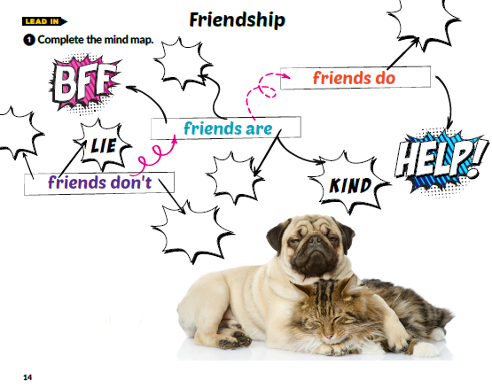
Laugh
with you.
friendly.
say rude words.
generous.
avoid you.

Slide 7
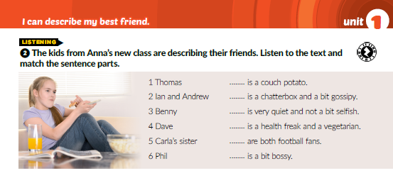
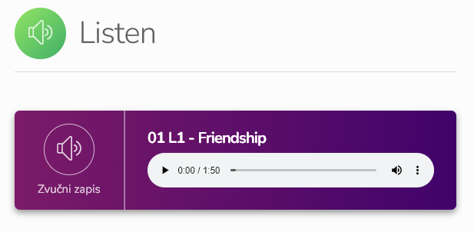
6
1
4
5
2
3
https://www.e-sfera.hr/dodatni-digitalni-sadrzaji/1f2df562-8db1-43f4-a818-218431226cf4/

Slide 8
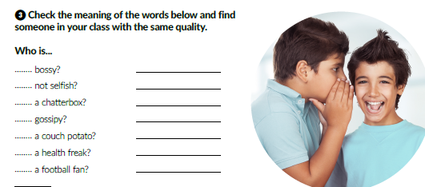

orders you what to do
shares her or his things with you
talks all the time
tells stories, or lies, about other people
watches TV all the time, a lazy person
worries about his or her health and food
loves football very much

Slide 9
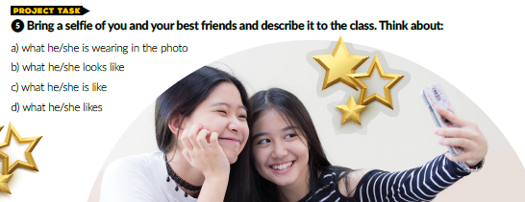

Slide 10
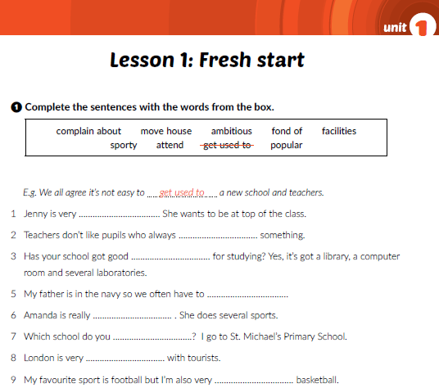
Workbook p. 5
ambitious
complain about
facilities
move house
sporty
attend
popular
fond of

Slide 11
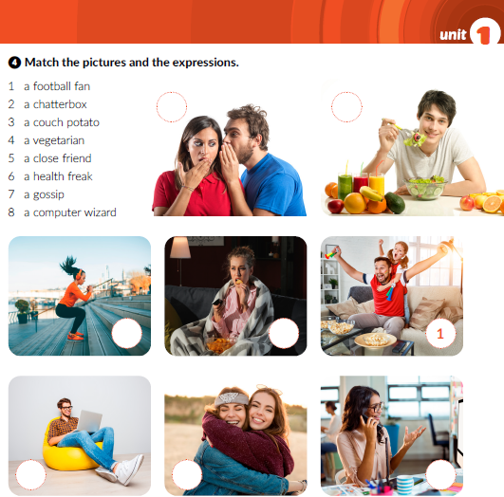
Workbook p. 7
7
4
6
3
8
5
2

Slide 12
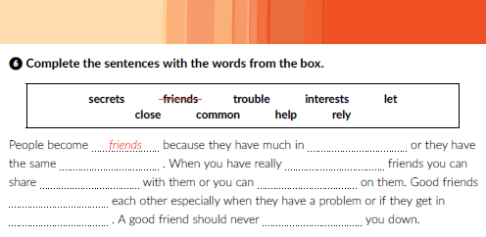
common
interests
close
secrets
rely
help
trouble
let
Workbook p. 8

Slide 13
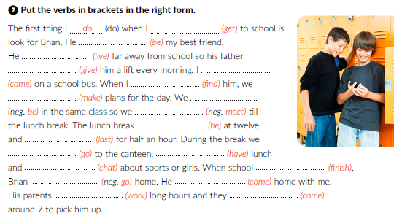
get
is
lives
gives
come
find
make
are not
don‘t meet
is
lasts
go
have
chat
finishes
doesn‘t go
comes
work
come
Workbook p. 8

Slide 14
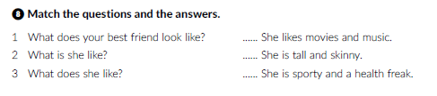
3
2
1

Slide 15

Otvori sljedeću poveznicu, odaberi Play and Learn, te Pokreni.
Lesson 1 Fresh start | Way to go 4 (e-sfera.hr)

